Slide 1

Babylon Project -Team
Stock Rebel

Slide 2
Problem Statement
Stock Investment needs a option for selecting and investing in accurate prediction Model.
Solution:Stock Rebel is the Blockchain platform, for hosting AI based model - marketplace.
Here clients can bid and invest in this crowd funding model

Slide 3
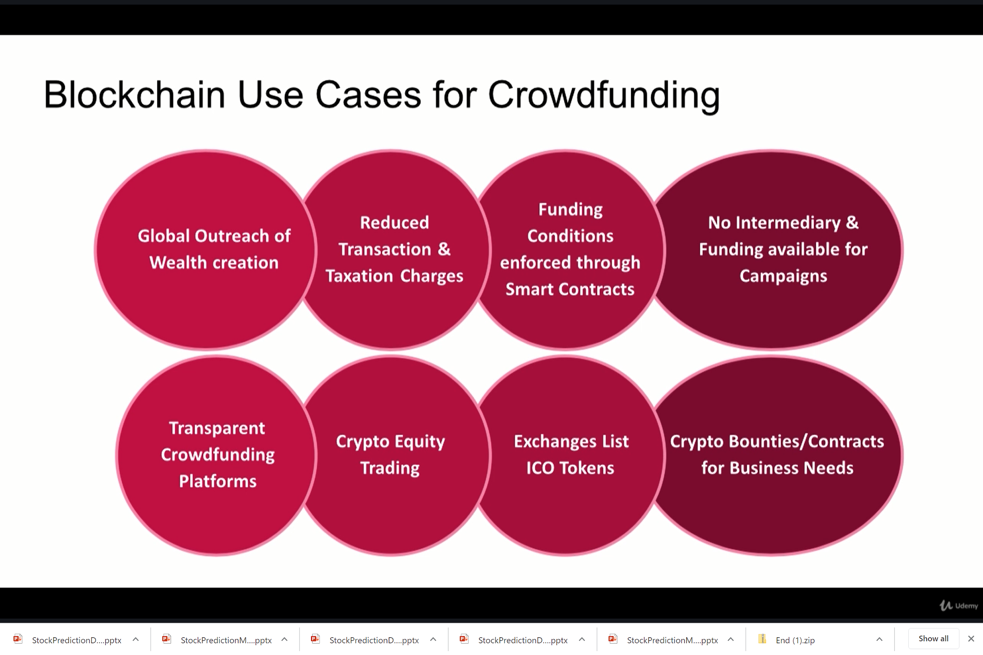
Babylon Project -Team
Stock Rebel
Stock Prediction Model

Slide 4
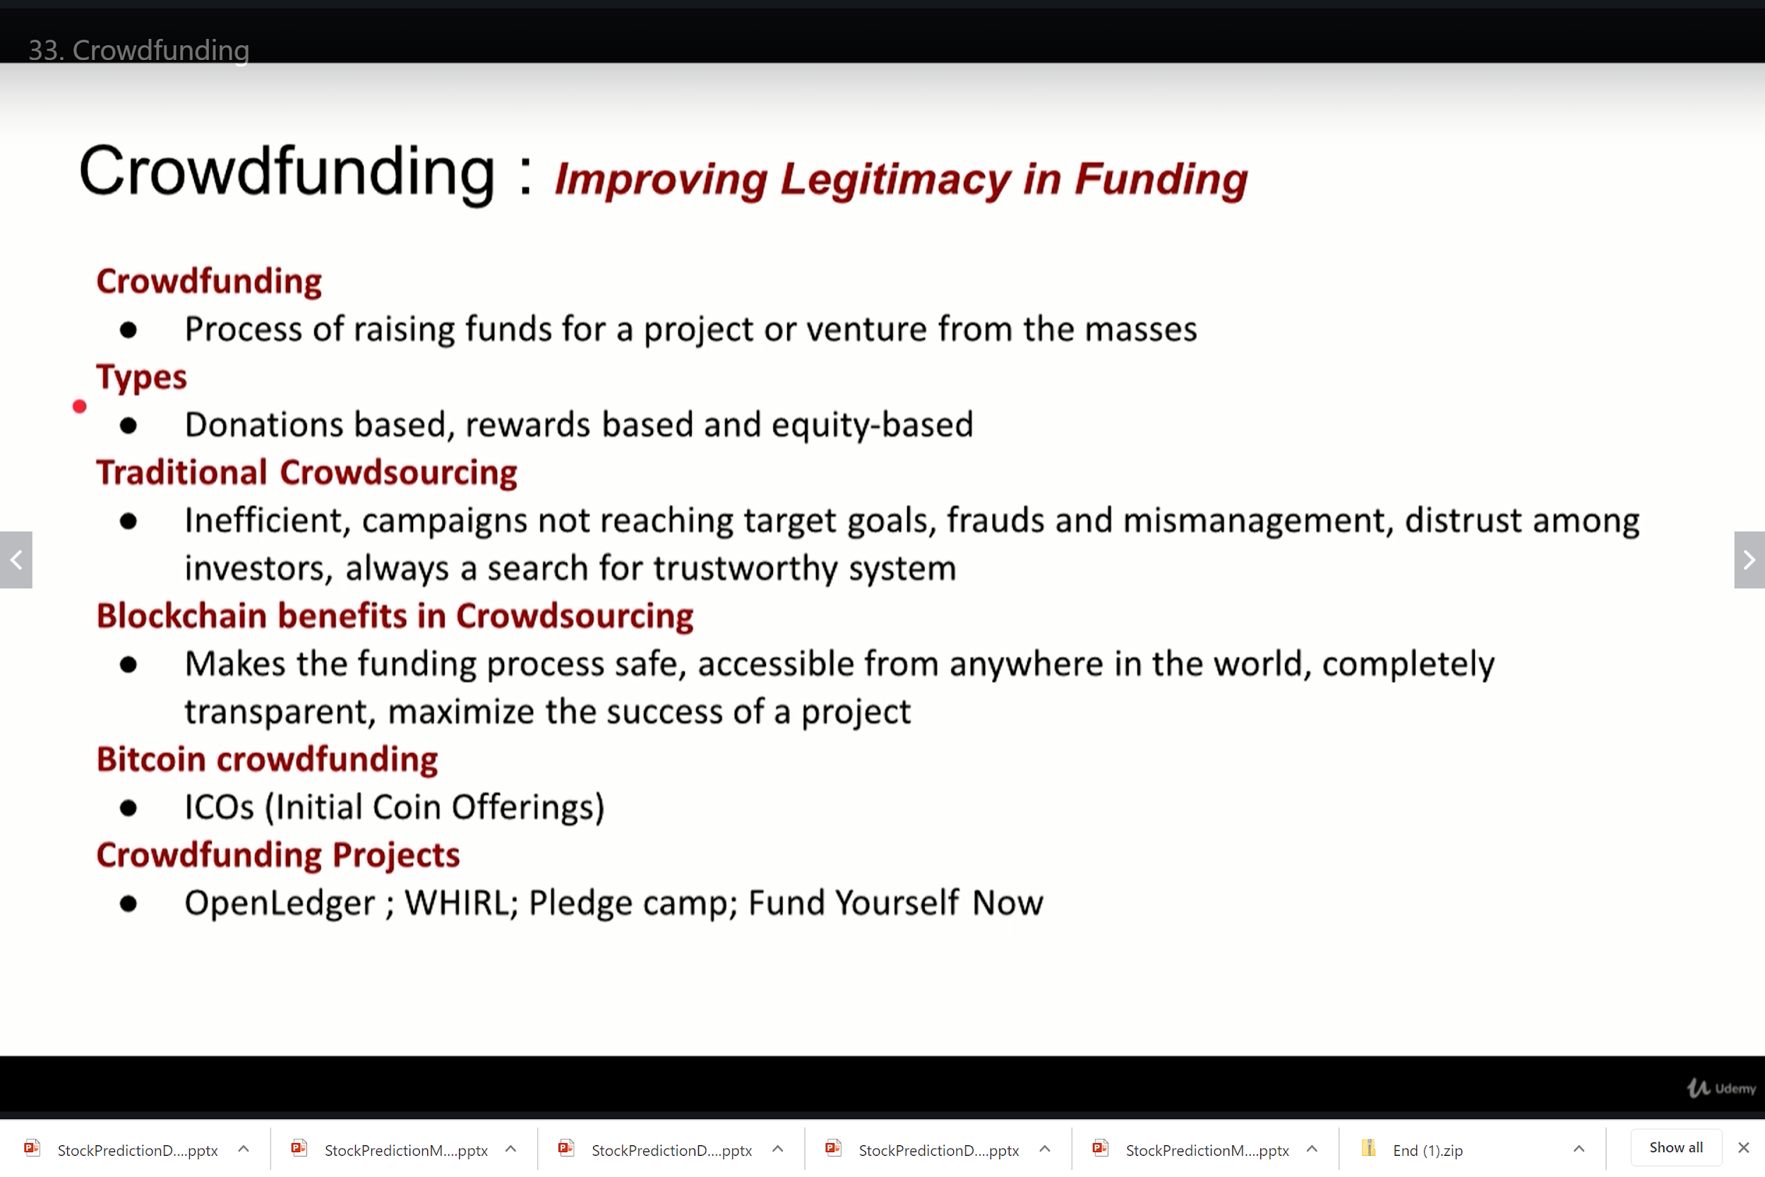
Babylon Project -Team
Stock Rebel

Slide 5
StockRebel: A Blockchain Platform For - AI based Stock Prediction :Data extraction and analysis.
Deep learning model to predict biostock
List of Stocks:
Eli Lilly and Company (NYSE:LLY), Bristol-Myers Squibb (NYSE:BMY), Johnson & Johnson (NYSE:JNJ) AbbVie (NYSE:ABBV), Merck (NYSE:MRK), Zoetis (NYSE:ZTS), Perrigo Company (NYSE:PRGO), Elanco Animal Heath (NYSE:ELAN). Teva Pharmaceutical Industries Limited (NYSE:TEVA), Novo Nordisk (NYSE:NVO)
The id of the tweets of given stocks are extracted.Time line : 2 year data were analyzed for prediction

Slide 6
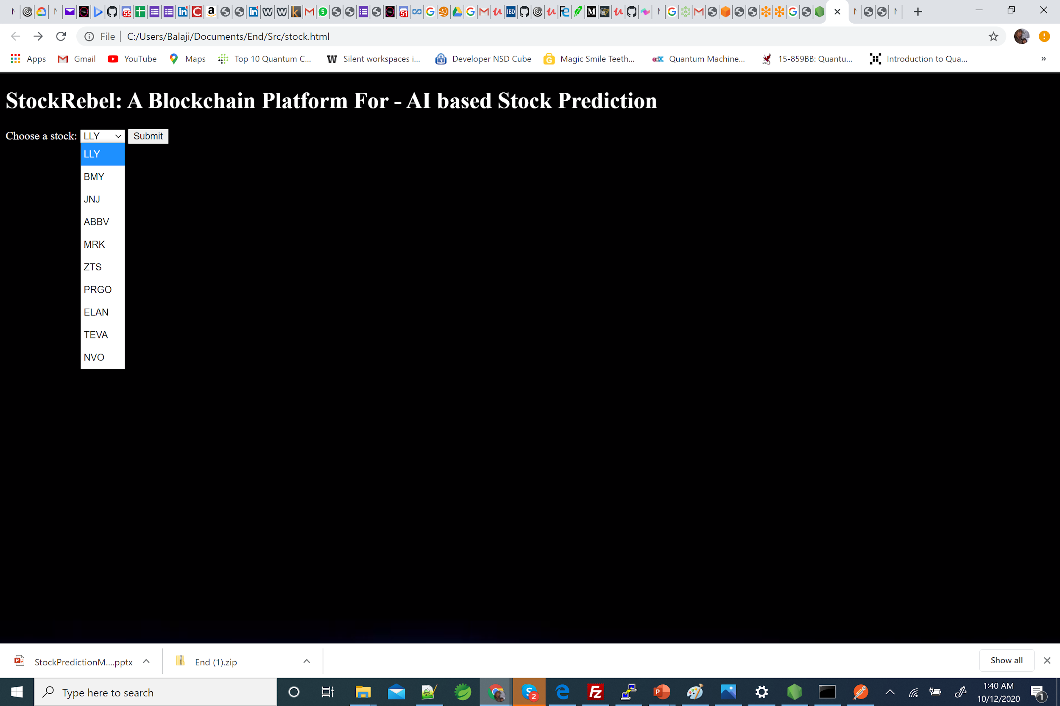
Stock Rebel : Predictive engine MVP

Slide 7
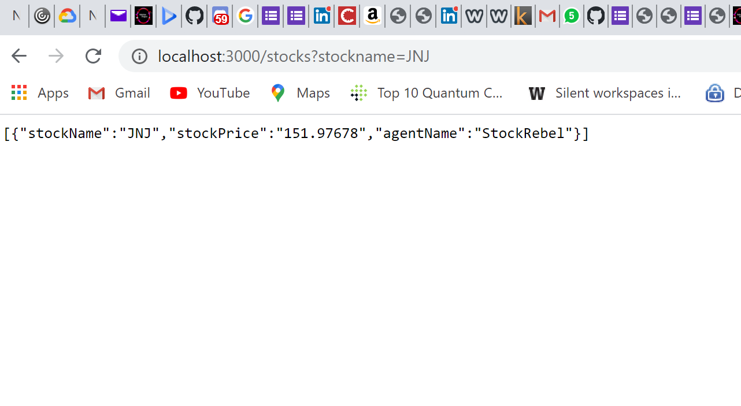
Stock Rebel: AI based predictive model in Blockchain
Stock Rebel : Predictive engine MVP

